Slide 1
MSRP Project: BioChemInsights, Inc.
Presented by
Priyanka
Yixian
Mengfang
Guided by :
Clifford Morrison
May 3rd, 2017

Slide 2
Agenda
Executive Summary
Who are we working with?
Problem Statement
Human costs of contaminated water
Causes of nitrate contamination
Geographical locations with the problem
Cost of alternate drinking sources
Cost of nitrate cleaning
Future steps

Slide 3
Executive Summary
Problem – Nitrate (NO₃)⁻¹ contamination in drinking water in the USA.
Solution – Nitrate remediation through electro-biochemical denitrification via a reactor.
Goal – To assess the market size, dollar to dollar impact of the product.
Data Sources - USGS WATSTORE database and related state databases and information systems.
Findings – Geographical locations that show the most pronounced problems and related cost of cleaning water.

Slide 4
Who are we working with?
Dr. Bill Armiger – CEO of BioChemInsights Inc.
Clifford Morrison – PhD, Chemical and Biological Engineering , Dr. Mattheos Koffas Lab group

Slide 5
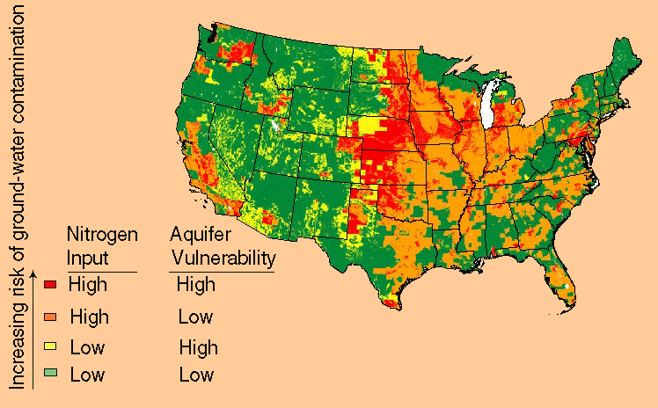
Problem statement
Nitrate contamination in drinking water a widespread problem in many regions in the United States.

Slide 6
Human costs of nitrate contaminated water
Case study at San Joaquin valley, epicenter of nitrate challenge
75% of the nitrate exceedances in 2007
Number of wells with nitrate levels above MCL will double by 2020
Nitrate exposure on infants, impacts to spleen, kidney and thyroid functions – potentially fatal- an urgent public health issue.
Conditions like infant methemoglobinemia – fatal blood disorder
Household surveyed (37) had water costs above national affordability standards (almost 3X) – 4.6% of median household income.
Funded by CDPH Cost for nitrate contamination – $100,000 to $7.5 million.
100 projects are on waiting list of total cost $150 million
Most common solution : New well construction
Followed by Consolidation and installation of treatment technology.

Slide 7
Causes of nitrate contamination
In 1995, agricultural producers added 36 billion pounds of nitrogen to the environment.
Excess of nitrogen entered reservoirs, rivers and groundwater.
Agricultural activities account for over 80 percent of all nitrogen.
Animal manure is the second largest source of nitrogen in the environment.
Non-agricultural sources of nitrogen contribute less than 20 percent of the nitrogen in the environment.

Slide 8
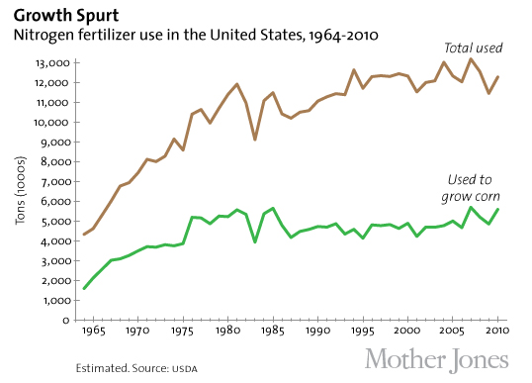
Causes of nitrate contamination and why is it here to stay for a long time?

Slide 9
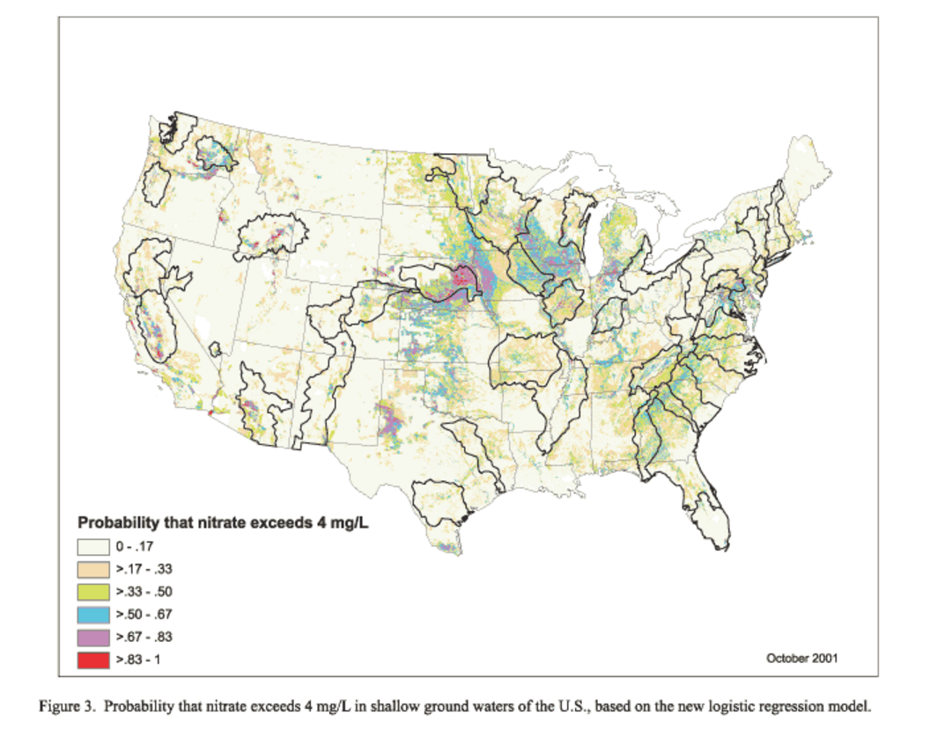
Geographical locations with most pronounced problems (1)
Northeastern USA Livestock operations area
Central USA Grain belt
California and Texas irrigated agricultural regions

Slide 10
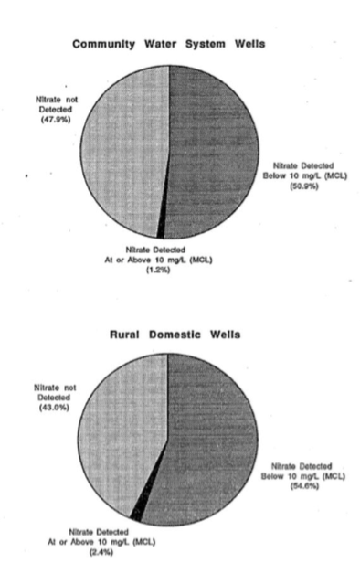
Geographical locations with most pronounced problems (2)
Standard level for drinking water is 10 mg/L and shallow wells account for high nitrate concentration
The highest nitrate level occurs in the middle area of US(Iowa, Nebraska, Kansas)

Slide 11
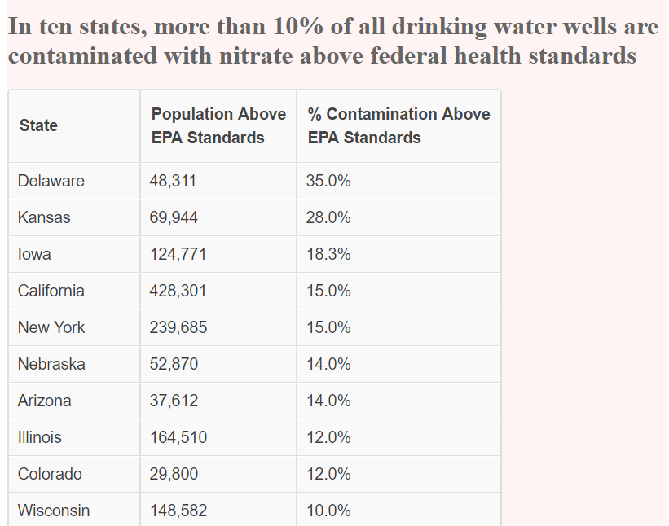
Locations with nitrate levels above federal health standards – Potential market for the product

Slide 12
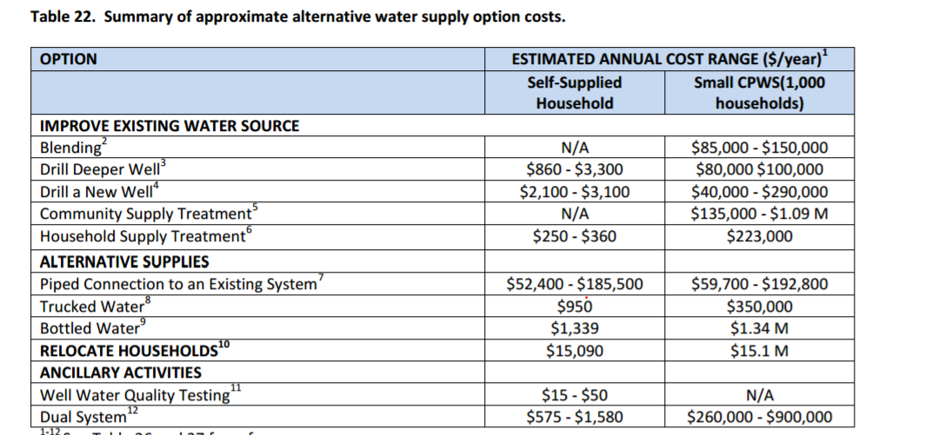
Cost of alternate drinking water sources

Slide 13
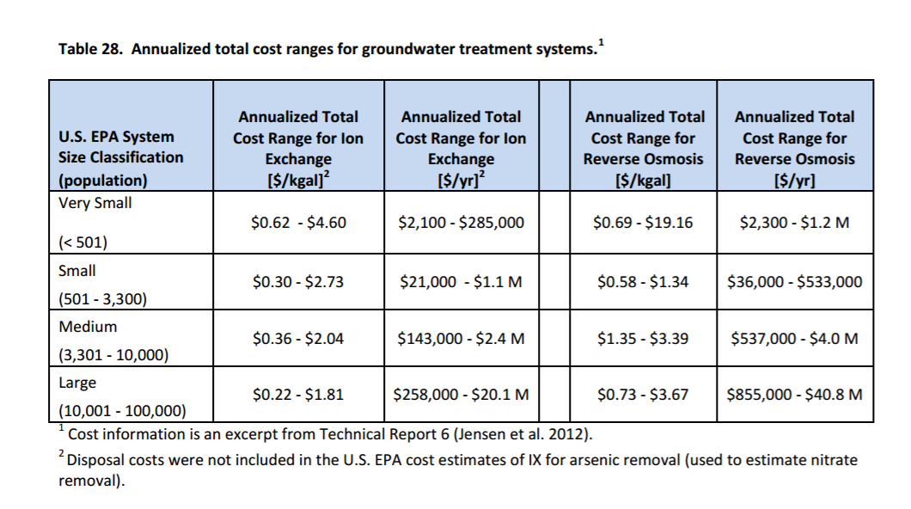
Cost of nitrate cleaning

Slide 14
Takeways
Answer to the big question, is nitrate contamination really a big problem– YES!
How is this problem mostly dealt with? – Abandon area, dig new wells, Ion Exchange & Reverse Osmosis
Nitrate contaminated water cleaning product in the market a low hanging fruit? – Yes, definitely.
NY, IL and IA has the most population impacted by this problem. DE, KA and IA most percentage of drinking well impacted.
Cost of cleaning water uses Ion Exchange & Reverse Osmosis per gallon of water : $0.22-1.81 & $0.37-3.67 respectively

Slide 15
Q&A Thank you!

